Slide 1
Elasticity and Revenue
Module 2 · Video 1
Management 405
Prof. Nico Voigtländer · UCLA Anderson

Slide 2
Module 2 · Video 1 · Agenda
Outline of Module 2
1
In class
The Law of Demand
2
In class
Elasticities
3
Demand and Revenue
How the demand curve translates into total revenue
Videos 1+2
Elasticity and Revenue
When a price increase raises revenue – and when it backfires
3a
Video 1
3b
Video 2
Marginal Revenue
4
Video 3
Demand Estimation
▶ Teaching Note – Demand Elasticity and Total Revenue On BL under “Module 2 Post-Work”
Management 405 · Module 2 · Demand Analysis
2

Slide 3
Module 2 · Video 1 · Elasticity and Revenue
Plotting the (Inverse) Demand Curve
P
Demand function Q = 1,600 − 4P Rearrange for P: Inverse demand function P = 400 − Q/4
[this is what we plot]
$400
D
1600
Q
Note: this is the (inverse) demand function that a single firm faces
Management 405 · Module 2 · Demand Analysis
3
Notes:
We can now explore the relationship between the elasticity of demand and total revenue. Total revenue is defined as ⟪𝑇𝑅⟫⟪=⟫⟪𝑃⟫⟪∙⟫⟪𝑄⟫. Starting at the leftmost portion of the graph, when ⟪𝑄⟫⟪=0⟫, we know that ⟪𝑇𝑅⟫⟪=0⟫. As the price falls, quantity rises. Note that these changes have opposing effects on total revenue. Since we are on the elastic portion of the demand curve, we know that a small decrease in price causes a large increase in quantity, and total revenue increases. This pattern will hold as price falls through the point of unit elasticity on the demand curve. At this point, total revenue reaches its maximum. After this point, we enter the inelastic portion of the demand curve. On the inelastic portion of the demand curve, we know that a small decrease in price causes an even smaller increase in quantity, and total revenue falls. Total revenue continues to fall until the demand curve intersects the x-axis, where ⟪𝑃⟫⟪=0⟫, and ⟪𝑇𝑅⟫⟪=0⟫.
When you lower your price and move down the demand curve, there are two effects on revenues: 1) a positive effect from more quantity sold and 2) a negative effect from a lower price per unit. Which area is bigger? It depends on the elasticity of demand.
Case of elastic demand: TR=P×Q. If P ↓ by 10% and Q ↑ by 20%, TR ↑. In the elastic zone of the demand curve (low Q, high P), the revenue curve rises. What can we say about the direction in which profits move here? It is ambiguous because of costs. Since quantity sold is rising, costs are also (weakly) rising. Profit can rise or fall, depending on how much costs increase.
Case of inelastic demand: TR=P×Q. If P ↓ by 10% and Q ↑ by 5%, TR ↓. In the inelastic zone of the demand curve (high Q, low P), the revenue curve is downward sloping. The prescription is clear here. If you are on the inelastic part of the demand curve, raise the price. Revenues rise, you sell less, so costs go down. Since revenues rise and costs go down, you know profits must be going up.
Does that mean that profits are maximized when E_d=-1? No. When E_d=-1, revenues are maximized. Marginal revenue is zero. That is not the same as MR=MC. Only when MR=MC are profits maximized. Usually, this is when E_d<-1, i.e. in the elastic zone of the demand curve, where MR is positive and allows you to cover marginal cost. You only want to stop at MR=0 (E_d=-1) if MC=0.

Slide 4
Module 2 · Video 1 · Elasticity and Revenue
From Demand to Total Revenue
P
$400
200
Inverse demand: P = 400 − Q/4
Total revenue: TR = P · Q
(illustrate for P=200)
Plug in for P: TR = (400 − Q/4) · Q
TR = 400Q − Q²/4
Total revenue
D
TR
800
1600
Q
$160,000
800
1600
Q
Management 405 · Module 2 · Demand Analysis
4
Notes:
We can now explore the relationship between the elasticity of demand and total revenue. Total revenue is defined as ⟪𝑇𝑅⟫⟪=⟫⟪𝑃⟫⟪∙⟫⟪𝑄⟫. Starting at the leftmost portion of the graph, when ⟪𝑄⟫⟪=0⟫, we know that ⟪𝑇𝑅⟫⟪=0⟫. As the price falls, quantity rises. Note that these changes have opposing effects on total revenue. Since we are on the elastic portion of the demand curve, we know that a small decrease in price causes a large increase in quantity, and total revenue increases. This pattern will hold as price falls through the point of unit elasticity on the demand curve. At this point, total revenue reaches its maximum. After this point, we enter the inelastic portion of the demand curve. On the inelastic portion of the demand curve, we know that a small decrease in price causes an even smaller increase in quantity, and total revenue falls. Total revenue continues to fall until the demand curve intersects the x-axis, where ⟪𝑃⟫⟪=0⟫, and ⟪𝑇𝑅⟫⟪=0⟫.
When you lower your price and move down the demand curve, there are two effects on revenues: 1) a positive effect from more quantity sold and 2) a negative effect from a lower price per unit. Which area is bigger? It depends on the elasticity of demand.
Case of elastic demand: TR=P×Q. If P ↓ by 10% and Q ↑ by 20%, TR ↑. In the elastic zone of the demand curve (low Q, high P), the revenue curve rises. What can we say about the direction in which profits move here? It is ambiguous because of costs. Since quantity sold is rising, costs are also (weakly) rising. Profit can rise or fall, depending on how much costs increase.
Case of inelastic demand: TR=P×Q. If P ↓ by 10% and Q ↑ by 5%, TR ↓. In the inelastic zone of the demand curve (high Q, low P), the revenue curve is downward sloping. The prescription is clear here. If you are on the inelastic part of the demand curve, raise the price. Revenues rise, you sell less, so costs go down. Since revenues rise and costs go down, you know profits must be going up.
Does that mean that profits are maximized when E_d=-1? No. When E_d=-1, revenues are maximized. Marginal revenue is zero. That is not the same as MR=MC. Only when MR=MC are profits maximized. Usually, this is when E_d<-1, i.e. in the elastic zone of the demand curve, where MR is positive and allows you to cover marginal cost. You only want to stop at MR=0 (E_d=-1) if MC=0.

Slide 5
Module 2 · Video 1 · Elasticity and Revenue
Effect of a Price Change on Total Revenue
P
Reduction in TR from a lower price
Increase in TR from higher volume
P₀
P₁
Which area is bigger?
→ Determines the net effect on TR
TR₀
We will see next: Which area is bigger depends on the elasticity of demand and P₀
D
Q₀
Q₁
Q
Management 405 · Module 2 · Demand Analysis
5

Slide 6
Module 2 · Video 1 · Elasticity and Revenue
Effect of a Price Change on Total Revenue: It Depends on E_{D}
P
E_{D} < −1 elastic
E_{D} = −1
−1 < E_{D} < 0 inelastic
D
TR
Q
TR
Elastic region: P falls → Q rises → TR rises
Inelastic region: P falls → Q rises → TR falls
Q
Management 405 · Module 2 · Demand Analysis
6
Notes:
We can now explore the relationship between the elasticity of demand and total revenue. Total revenue is defined as ⟪𝑇𝑅⟫⟪=⟫⟪𝑃⟫⟪∙⟫⟪𝑄⟫. Starting at the leftmost portion of the graph, when ⟪𝑄⟫⟪=0⟫, we know that ⟪𝑇𝑅⟫⟪=0⟫. As the price falls, quantity rises. Note that these changes have opposing effects on total revenue. Since we are on the elastic portion of the demand curve, we know that a small decrease in price causes a large increase in quantity, and total revenue increases. This pattern will hold as price falls through the point of unit elasticity on the demand curve. At this point, total revenue reaches its maximum. After this point, we enter the inelastic portion of the demand curve. On the inelastic portion of the demand curve, we know that a small decrease in price causes an even smaller increase in quantity, and total revenue falls. Total revenue continues to fall until the demand curve intersects the x-axis, where ⟪𝑃⟫⟪=0⟫, and ⟪𝑇𝑅⟫⟪=0⟫.
When you lower your price and move down the demand curve, there are two effects on revenues: 1) a positive effect from more quantity sold and 2) a negative effect from a lower price per unit. Which area is bigger? It depends on the elasticity of demand.
This is a powerful idea! If you know whether your demand is elastic or inelastic, you can predict whether revenues will rise of fall when you reduce prices (or vice-versa when you raise prices)
Case of elastic demand: TR=P×Q. If P ↓ by 10% and Q ↑ by 20%, TR ↑. In the elastic zone of the demand curve (low Q, high P), the revenue curve rises. What can we say about the direction in which profits move here? It is ambiguous because of costs. Since quantity sold is rising, costs are also (weakly) rising. Profit can rise or fall, depending on how much costs increase.
Case of inelastic demand: TR=P×Q. If P ↓ by 10% and Q ↑ by 5%, TR ↓. In the inelastic zone of the demand curve (high Q, low P), the revenue curve is downward sloping. The prescription is clear here. If you are on the inelastic part of the demand curve, raise the price. Revenues rise, you sell less, so costs go down. Since revenues rise and costs go down, you know profits must be going up.
Does that mean that profits are maximized when E_d=-1? No. When E_d=-1, revenues are maximized. Marginal revenue is zero. That is not the same as MR=MC. Only when MR=MC are profits maximized. Usually, this is when E_d<-1, i.e. in the elastic zone of the demand curve, where MR is positive and allows you to cover marginal cost. You only want to stop at MR=0 (E_d=-1) if MC=0.

Slide 7
Module 2 · Video 1 · Elasticity and Revenue
Effect of a Price Change on Total Revenue: It Depends on E_{D}
Total Revenues: $TR = P ⋅ Q$
In % changes, this implies: $\%ΔTR = \%ΔP + \%ΔQ$
To assess the effect of a price decrease on revenue, ask:
[note: if P decreases, Q must increase]
Is the % reduction in P smaller than the % increase in Q? If yes: total revenue rises → Demand is elastic
Is the % reduction in P larger than the % increase in Q? If yes: total revenue declines → Demand is inelastic
Management 405 · Module 2 · Demand Analysis
7

Slide 8

Module 2 · Video 1 · Elasticity and Revenue
What Can a Price Cut and Revenues Tell Us About the Elasticity?
Novo Nordisk lowered its U.S. price for Ozempic and Wegovy under a deal with the White House
As a result, revenues are forecasted to fall 5–13%
What does this imply about the elasticity of demand?
Elastic?
Inelastic?
E_{D}=−1 (unit elastic)?
Need more information?
Source: Pharmaceutical Technology
Poll Break
Management 405 · Module 2 · Demand Analysis
8
Notes:
A current example, from early 2026: under a deal with the White House, Novo Nordisk cut the U.S. self-pay price of Ozempic and Wegovy from $499 to $349 a month. The company then guided 2026 sales revenues down by 5 to 13%. Ask yourself what a price cut that REDUCES revenue tells you about the elasticity of demand.

Slide 9
Module 2 · Video 1 · Elasticity and Revenue
Solution
Demand is inelastic
A price cut caused TR to fall
The quantity response was too small to offset the price cut
Inelastic: |E_{D}| < 1
Management 405 · Module 2 · Demand Analysis
9

Slide 10
Module 2 · Video 1 · Elasticity and Revenue
What About Profits?
Profit = Revenue − Costs
We know: The price decrease caused TR to decrease
A declining price also raises quantity produced/sold Q → costs increase
Thus: Profits fell
Markets agreed: Novo Nordisk shares tumbled ~18%
Management 405 · Module 2 · Demand Analysis
10
Notes:
One step further: profit is revenue minus costs. The price cut reduced revenue, and because quantity sold rises, production costs rise too — so profits fall on both ends. The market agreed: when Novo Nordisk warned in February 2026 that lower U.S. prices would push 2026 sales and operating profit down 5 to 13%, its shares tumbled about 18%.

Slide 11
Module 2 · Video 1 · Elasticity and Revenue
Summary: Effect of a Price Change on TR — It Depends on E_{D}
Is the percent reduction in price greater or smaller than the percent increase in quantity sold?
More precisely: is demand elastic or inelastic?
% change in P | Resulting % change in Q | Demand is… | Resulting change in revenue
If P decreases | Relatively large increase in Q | Elastic | Revenue increases
If P decreases | Relatively small increase in Q | Inelastic | Revenue decreases
If P increases | Relatively large decline in Q | Elastic | Revenue decreases
If P increases | Relatively small decline in Q | Inelastic | Revenue increases
Management 405 · Module 2 · Demand Analysis
11

Slide 12
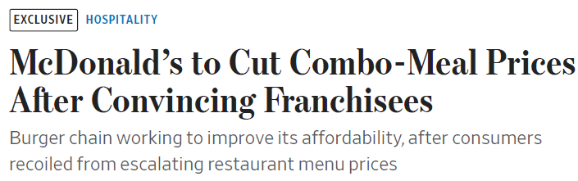
Module 2 · Video 1 · Elasticity and Revenue
Why Is McDonald's Cutting Prices?
What does this suggest about its demand elasticity?
Elastic?
Inelastic?
Need more information?
What are the implications for 1) revenue and 2) profit given this elasticity?
Rise?
Fall?
Unchanged?
Need more information?
Poll Break
Management 405 · Module 2 · Demand Analysis
12
Notes:
A live example from 2025: McDonald's and its U.S. franchisees agreed to cut combo-meal prices by about 15% relative to buying the items separately, and extended the value menu in 2026. Notable detail for the franchisee question: McDonald's set aside roughly $35 million to compensate operators hit by the lower prices — side payments to align incentives across locations with different demand elasticities.

Slide 13
Marginal Revenue
Module 2 · Video 2
Management 405
Prof. Nico Voigtländer · UCLA Anderson

Slide 14
Module 2 · Video 2 · Agenda
Outline of Module 2
1
In class
The Law of Demand
2
In class
Elasticities
3
Videos 1+2
Demand and Revenue
3a
Video 1
Elasticity and Revenue
Marginal Revenue
The extra revenue from selling one more unit
3b
Video 2
4
Video 3
Demand Estimation
Management 405 · Module 2 · Demand Analysis
14

Slide 15
Module 2 · Video 2 · Marginal Revenue
Context: Why Do We Care About Marginal Revenue?
General objective: maximize net benefits
Use marginal analysis
Net benefits are maximized where MB = MC
Firms’ objective: maximize profits
Produce where Marginal Revenue (MR) = Marginal Cost (MC)
Today: how to compute MR
Management 405 · Module 2 · Demand Analysis
15

Slide 16
Module 2 · Video 2 · Marginal Revenue
Marginal Revenue: Definition
Intuitively: Additional revenue from selling one more unit
Mathematically: How much total revenue changes when quantity sold increases by one unit
$$MR = \frac{ΔTR}{ΔQ} = \frac{dTR}{dQ}$$
Derivative
How to compute MR : start from the demand function and use a 3-step method
Management 405 · Module 2 · Demand Analysis
16

Slide 17
Module 2 · Video 2 · Marginal Revenue
Calculus Refresher: Derivatives
A derivative measures a rate of change. dY/dX is the change in Y caused by a small (marginal) change in X
The general rule
A worked example
If $Y = a + bX + cX^{2}$
with a, b, c constant,
then $\frac{dY}{dX} = b + 2cX$
With a = 1, b = 3, c = 2:
$Y = 1 + 3X + 2X^{2}$
$\frac{dY}{dX} = 3 + 2⋅2⋅X = 3 + 4X$
→ See TA’s Math Review Videos
Management 405 · Module 2 · Demand Analysis
17

Slide 18
Module 2 · Video 2 · Marginal Revenue
3-Step Method to Compute Marginal Revenue
Suppose demand is: Q = 1,600 − 4P
Step 1: Calculate inverse demand (solve for P)
Rearrange demand so P is a function of Q: P(Q)
$$P = 400 − \frac{1}{4}Q$$
Step 2: Calculate total revenue (multiply P(Q) by Q)
TR = P · Q; replace P with inverse demand so TR is a function of Q only
$$TR = (400 − \frac{1}{4}Q) ∙ Q = 400∙Q − \frac{1}{4}Q^{2}$$
Step 3: Compute Marginal Revenue from total revenue (MR = dTR/dQ)
Take the derivative of TR with respect to Q
$$MR = 400 − (2⋅\frac{1}{4})∙Q = 400 − \frac{1}{2}Q$$
✎ Problem Set 2
▤ Teaching Note: Marginal Revenue
Management 405 · Module 2 · Demand Analysis
18
Notes:
Marginal Revenue = Marginal Cost when Demand is Linear
To set MR=MC, you need to know MC. For now, we assume a constant marginal cost: MC=$200. The harder part is MR. What is marginal revenue? In words, it is the change in revenues when you sell one more unit of the good. To get there, we want to find out what total revenue is only as a function of Q, so that we can take the derivative of revenue with respect to Q.
Let's write down a specific demand function and work through an example using this demand function:
Q=1600-4P
The Recipe
There are three steps to get to the mathematical answer for MR. You can apply this recipe whenever you face this type of problem:
Invert your demand. That's the inconvenient legacy of Alfred Marshall that I mentioned in class:
P=400 - 1/4 Q
(If you're wondering what I did here, I just took our demand function, put P on the left side, Q on the right side and divided everything by 4).
Write down total revenue. What's total revenue? It is P times Q. So:
PQ=400Q-1/4 * Q^2
(Here I just multiplied the previous equation by Q: easy!)
Find Marginal Revenue. That's the hardest step. It entails taking the derivative of PQ with respect to Q. You may or may not know any calculus. But (I promise!) you can do this even if you don't know any calculus. All you need to know is that the derivative of Q with respect to Q is 1, and that the derivative of Q2 with respect to Q is 2Q:
MR=(∆PQ)/∆Q=400-1/2Q
So now we have MR. You will notice that MR has twice the slope of the inverse demand function. The slope of the inverse demand function is -1/4 and the slope of MR is -1/2. When demand is linear, MR is always twice as steep as demand.
Where MR=0, demand is unit elastic
Try to understand intuitively why the elasticity of demand is exactly -1 when MR=0!
Total revenue is maximized where E_d=-1. If MR>0, then TR must be rising as Q increases. If MR<0, then TR must be declining.
Note that your goal is to maximize profits, not total revenue. A consideration of costs matters.
Now we set MR equal to MC ($200) and we are done:
MR=MC
400-12Q=200
Q=400
So now we know that maximizing profits entails setting Q=400. What about the price P? Well, that's easy to find: our price-quantity combination must be located on the demand curve. So from the inverse demand we derived earlier, we find:
P=400-1/4Q=400-100=$300
Maximizing profits, here, entails setting Q=400 units and P=$300.

Slide 19
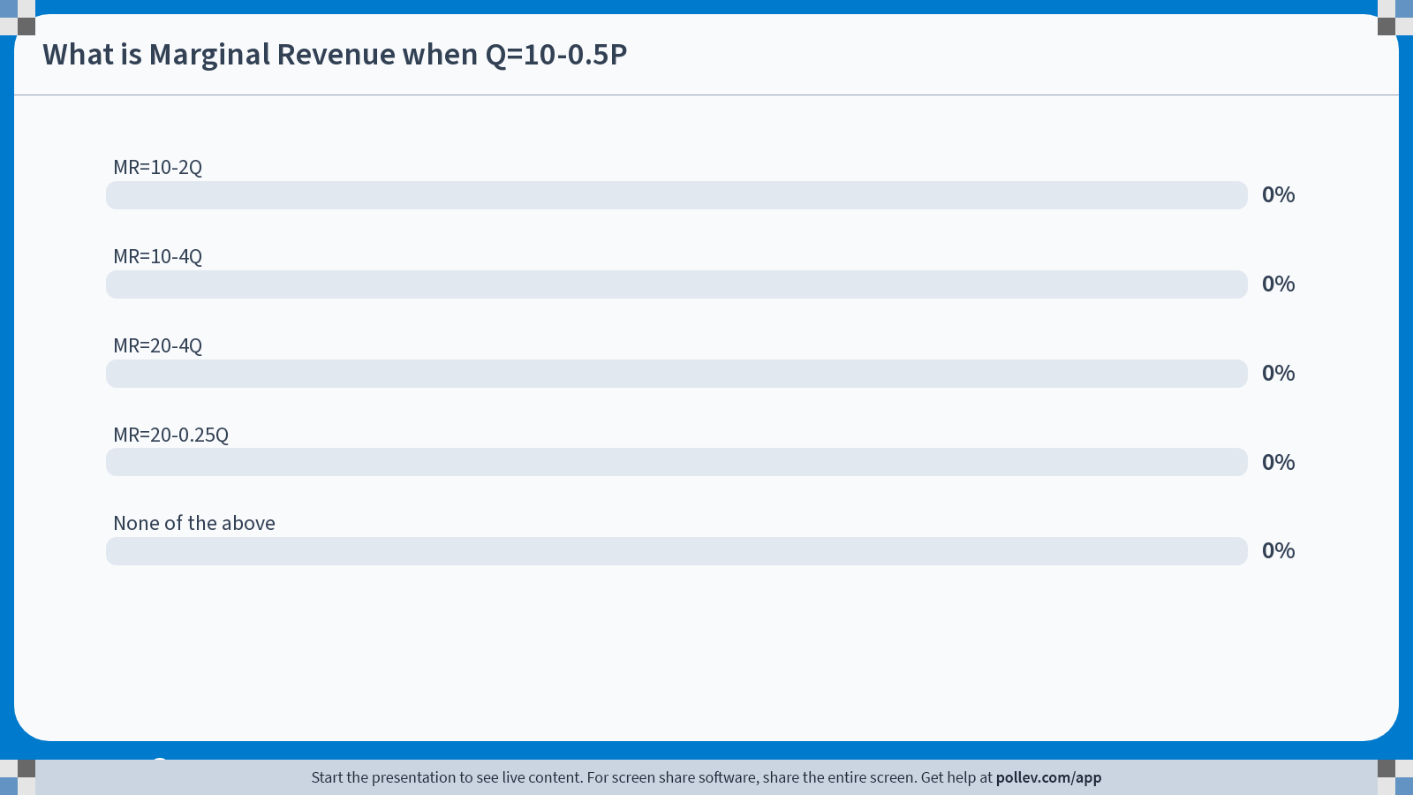
Poll Break
19
Notes:
Poll Title: Do not modify the notes in this section to avoid tampering with the Poll Everywhere activity. More info at polleverywhere.com/support What is Marginal Revenue when Q=10-0.5P https://www.polleverywhere.com/multiple_choice_polls/hj1ivMTBaXH6hMPPQBFLc?state=opened&flow=Default&onscreen=persist

Slide 20
Module 2 · Video 2 · Marginal Revenue
Solution: If Q = 10 − 0.5P , What Is MR ?
$$P = 20 − 2Q$$
1. Inverse Demand:
$$TR = (20 − 2Q) ∙ Q = 20Q − 2Q^{2}$$
2. Total revenue: TR = P ∙ Q
$$MR = \frac{dTR}{dQ} = 20 − 4Q$$
3. Derivative of TR w.r.t. Q:
Management 405 · Module 2 · Demand Analysis
20

Slide 21
Module 2 · Video 2 · Marginal Revenue
MR: Graphical Representation
P
400
Q = 1,600 − 4P
Elastic portion
P = 400 − Q/4
E_{D} = −1
TR = 400Q − Q²/4
Inelastic portion
MR
D
MR = 400 − Q/2
800
1600
Q
TR
TR is maximized where MR = 0
TR
800
Q
Management 405 · Module 2 · Demand Analysis
9
Notes:
Why isn’t MR just P?
For a firm with market power (which we will assume here), they will face downward sloping demand. In order to sell additional unit, it will have to lower the price. It will lower the price not just for the marginal unit, but for all units. This reduces the revenue the firm receives for the other units it sells. When computing the marginal revenue from the additional unit, it must also subtract the loss it suffers on every other unit.
Is there any situation under which MR=P?
Infinite elasticity. When the good is perfectly elastic, a firm doesn’t have to lower the price in order to sell more goods [quantity doesn’t depend on price]; the firm can sell any amount at a given price, so marginal revenue just equals P. This is known as perfect competition, which we will return to in the second half of the course when we discuss market power.
Can MR be negative?
Yes! In the left side of this plot, we see that MR is negative. To the right of the point of unit elasticity, TR is declining, meaning that each additional unit contributes negatively. That is another way of saying that MR is negative.

Slide 22
Module 2 · Video 2 · Marginal Revenue
Why Is MR Different From the Price?
MR : additional revenue from selling one more unit. Sounds like the price! But…
Law of demand: you need to lower the price to sell one more unit
The lower price will apply to all units, not just the extra one
MR from selling one additional unit takes into account the loss on every other unit → MR < P
Note: When MR < 0, Total Revenues (TR) decrease as price falls (and Q increases)
Management 405 · Module 2 · Demand Analysis
22

Slide 23
Demand Estimation
Module 2 · Video 3
Management 405
Prof. Nico Voigtländer · UCLA Anderson

Slide 24
Module 2 · Video 3 · Agenda
Outline of Module 2
1
In class
The Law of Demand
2
In class
Elasticities
3
Videos 1+2
Demand and Revenue
3a
Video 1
Elasticity and Revenue
3b
Video 2
Marginal Revenue
4
Demand Estimation
Measuring demand from data – market experiments and regression
Video 3
Management 405 · Module 2 · Demand Analysis
24

Slide 25
Module 2 · Video 3 · Demand Estimation
How to Estimate a Demand Curve?
Use regression analysis to estimate the relationship between price and quantity
Need data linking prices to quantities
Several approaches
Transaction data (marketing firms, internet shopping, store club cards)
Surveys
Market experimentation
Management 405 · Module 2 · Demand Analysis
25
Notes:
Here we can say that we'll focus on market experimentation = cleanest way + increasingly ued thanks to new technologies + we'll discuss at the end why better than using transaction data

Slide 26

Module 2 · Video 3 · Demand Estimation
A/B Testing: What Is the Demand Function for This Product?
Management 405 · Module 2 · Demand Analysis
26

Slide 27
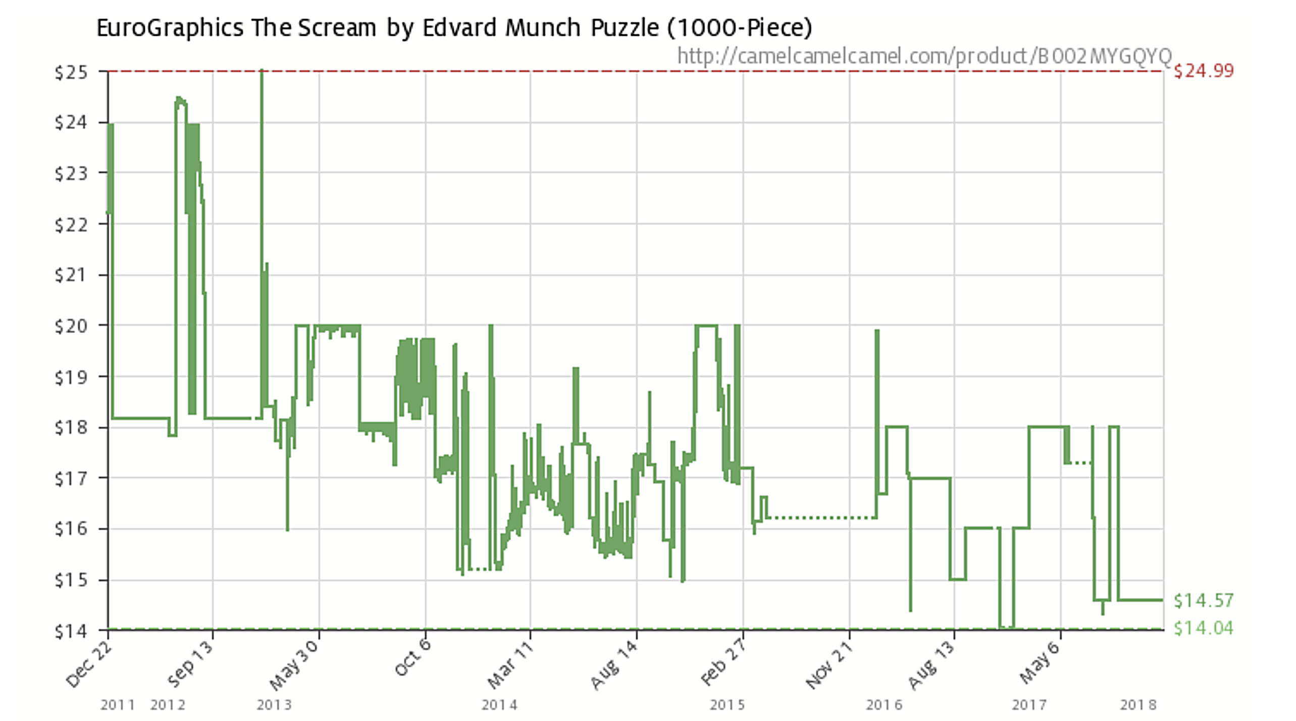
Module 2 · Video 3 · Demand Estimation
A/B Testing: Amazon “Experiments”
Management 405 · Module 2 · Demand Analysis
27

Slide 28

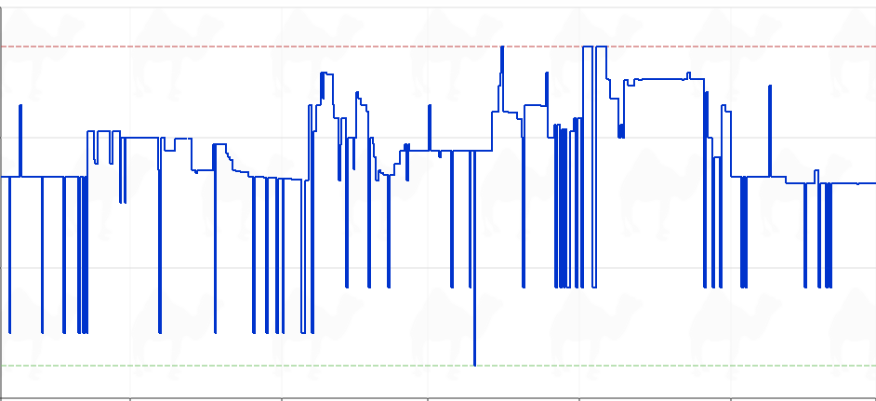
Module 2 · Video 3 · Demand Estimation
Recent Amazon “Experiments”
Pop Mart × Coca-Cola Labubu keychain
$90
$83.99
$70
$62.98
$50
$35.00
$30
May
Jun
Jul
Aug
Sep
camelcamelcamel.com
Management 405 · Module 2 · Demand Analysis
28
Notes:
camelcamelcamel.com is a free Amazon price tracker. It has followed Amazon listings since 2008 and plots the price history of a single product, marking the highest and lowest price it has ever recorded. The blue line on this slide is one listing over about five months, and the point is how restless it is: the price moves almost daily and swings between roughly $35 and $84 for the same item.
That is the illustration. Amazon is not running one A/B test and then settling on an answer, the way the previous slide's classic experiment does. It re-prices continuously, so the price variation we would need to estimate a demand curve is being generated all the time. The flip side is the warning that comes a few slides later: these price moves are not randomized, so quantity differences across high- and low-price days also reflect whatever else changed on those days (a holiday, a competitor's promotion, a stock-out).
The product above the chart is a Labubu, in case that name means nothing to you. Labubu is a character - an elf-like creature with pointed ears and a wide, serrated grin - created by the Hong Kong illustrator Kasing Lung for his picture-book series THE MONSTERS, which he started in 2015 and drew from Nordic folklore. In 2019 Lung signed an exclusive licence with Pop Mart, a Chinese designer-toy company, which turned the character into small vinyl and plush collectibles sold in BLIND BOXES: you pay for a sealed box and only find out which variant of the series you got when you open it, with one rare 'secret' version per case.
From about 2024 the toys became a global craze, helped by celebrities photographed with one clipped to a handbag, and Pop Mart's Labubu lines have been a large part of its revenue growth. The one on this slide is from the Coca-Cola collaboration series. That background is exactly why the price line is so restless: supply comes in limited drops, demand is faddish, and the listing gets re-priced constantly. Nothing in the economics turns on the product, though - any item with a volatile price would make the same point.

Slide 29
Module 2 · Video 3 · Demand Estimation
Econometric Estimates
Econometrics: combine economics, statistics, and mathematical model building
Develop hypotheses linking dependent variables (e.g., sales) to explanatory variables (e.g., price)
How: Least Squares regression analysis
Covered in detail in your Stats class
Today: A broad overview
What you need for our class: Interpret and use the estimated coefficients
Management 405 · Module 2 · Demand Analysis
29

Slide 30
Module 2 · Video 3 · Demand Estimation
Ordinary Least Squares: Estimating the Demand Function
Q = a + b · P
Q = dependent variable
P = independent variable
a = intercept with the y-axis (Q on y-axis)
b = slope of the regression line (demand curve)
$$E_{D} = \frac{ΔQ}{ΔP} · \frac{P}{Q} = b · \frac{P}{Q}$$
Management 405 · Module 2 · Demand Analysis
30
Notes:
The basic equation is a demand equation: Q=a+bP. We expect b<0, because that determines that the own-price elasticity is negative.

Slide 31

Module 2 · Video 3 · Demand Estimation
Airline Ticket Experimentation: Data
Price ($) | Seats sold
250.00 | 64
265.00 | 33
265.00 | 37
240.00 | 83
230.00 | 111
225.00 | 137
225.00 | 109
220.00 | 96
230.00 | 59
235.00 | 83
245.00 | 90
240.00 | 105
250.00 | 75
240.00 | 91
240.00 | 112
235.00 | 102
Management 405 · Module 2 · Demand Analysis
31

Slide 32
Module 2 · Video 3 · Demand Estimation
First Pass: Eyeball the Relationship
Scatterplot of Q versus P
Quantity
150
Which line provides the best fit?
100
50
220
240
260
Price ($)
Management 405 · Module 2 · Demand Analysis
32

Slide 33
Module 2 · Video 3 · Demand Estimation
Least Squares Estimation
Quantity
150
Least Squares Algorithm
1. Calculate all vertical distances
2. Square them
3. Sum them over all data points
4. Choose the line that minimizes the sum of squares
100
50
220
240
260
Price ($)
Management 405 · Module 2 · Demand Analysis
33

Slide 34
Module 2 · Video 3 · Demand Estimation
Regression Results for the Airline Data
Coefficient | Value
Constant (intercept) | 478.95
Own price | −1.64
Q = 478.95 − 1.64 P
Now that we have an estimated demand curve, we can compute MR (Following the 3 steps we’ve seen above)
Management 405 · Module 2 · Demand Analysis
34
Notes:
The intercept term is the value of a: horizontal intercept. When the price is zero you sell 479 units.
The price has a negative coefficient: b=-1.64. Price and volume are inversely related, as in a demand function. For every unit you drop the price, you get a 1.64 unit expansion in volume sold.
So now we have our values for a and b, respectively.

Slide 35
Module 2 · Video 3 · Demand Estimation
Application Using the Airline Demand Function
Q = 478.95 − 1.64 P
Use the estimated airline demand to compute:
What Is E_{D} at P = 140?
What Is MR at P = 140?
Can you provide a Pricing Recommendation?
✎ Problem Set 2
Poll Break
Management 405 · Module 2 · Demand Analysis
35
Notes:
So, can we do better than an R2 of 0.59? Yes. Economics tells us a lot of other things besides your own price drive demand: income, price of substitutes, how much you spend on promotion and advertising, etc. So let’s include them in the regression and see what happens. -> even if we have randomized prices, these factors might change and including them will increase precisions
The multivariate model includes two additional regressors or independent variables:
1. There is a competitor with a substitute product available (say United versus American)
2. You have data on average income in the US at the time of the sales. That is a factor that influences demand (what is the expected direction? Positive if air travel is a normal good).
Move to multiple regression module of the Excel workbook. Units are $ for price but an index for the income level. Run a multivariate regression of quantity on own price, price of substitute and income. The dependent variable stays the same, the independent variables now include Y and Pc.
On Problem Set 2, you will have the opportunity to run a regression, and interpret and use the coefficients!

Slide 36
Module 2 · Video 3 · Demand Estimation
Solution: E_{D} at P=140
Q = 478.95 − 1.64 P
Recall E_{D} = (ΔQ/ΔP) · (P/Q)
ΔQ/ΔP is the slope of demand ⇒ ΔQ/ΔP = −1.64
Plug P in to get Q: Q = 478.95 − 1.64 · 140 = 249.35
E_{D} = −1.64 · (140 / 249.35) = −0.92
Demand is inelastic
Management 405 · Module 2 · Demand Analysis
36
Notes:
What has changed?
The coefficient on Pc, which is dQ/dPc, equals 1.04. This indicates how my quantity sold changes with a one unit change in the competitor’s price. Since the product is a substitute, I expect a positive sign, which is what we get.
The coefficient on Y is 3.09 indicating a normal good. For every 1 point increase in the index of income, you get a 3.09 increase in airline seats sold.
You can derive elasticities from these numbers.
There is not much meaning to the intercept here – value of Q is all the independent variables are zero.
Note that R2 (which is not stated on this slide) is now up to 0.88, which mean 88% of the variation in Q is explained by our model, so we are doing much better. R2 always goes up when you include more variables, but how much it goes up matters.

Slide 37
Module 2 · Video 3 · Demand Estimation
Solution: MR at P=140
3-step method
1. Inverse demand: P = 292 − (1/1.64) Q
2. Total revenue: TR = 292 Q − (1/1.64) Q²
3. Derivative: MR = 292 − 1.22 Q
MR at P = 140?
P = 140 → Q = 249.35 → MR = −12
Management 405 · Module 2 · Demand Analysis
37

Slide 38
Module 2 · Video 3 · Demand Estimation
Solution: Raise the Price
P
MR is negative
So you want to sell less
By increasing the price
Elastic
E_{D} = −1
MR
Inelastic
D
Q
Management 405 · Module 2 · Demand Analysis
38

Slide 39
Module 2 · Video 3 · Demand Estimation
Note: We Can Also Run Multivariate Regressions
Incorporating other determinants of demand
$$Q = a + b · P + c · P_{c} + d · Y$$
Q = amount purchased
P = own price
P_{C} = competitor’s price
Y = income
Management 405 · Module 2 · Demand Analysis
39
Notes:
Other reported statistics (by Excel, R, or Stata) are interesting.
— The first is a measure of FIT. The better the overall fit, the closer the data points are to the regression line, i.e. the regression line captures a lot of the variation in the data. A measure of what we can explain. Here R2 is about 60%. We can explain 60% of the variation in quantity only using the price. Not bad, but there is room for improvement – 40% to be precise. The logical next step is to try to explain more. You can do that by adding more variables on the right hand side. If all the points were exactly on the regression line, we would have R2=1. Needless to say, that is almost never the case.
The second set of statistics measure statistical significance – i.e. how precisely each individual coefficient is measured. You can look at the standard error of your estimate, or the t-statistic that is simply the coefficient divided by the standard error. The rule of thumb is you want the absolute value of the t-statistic to be greater than 2 – for enough precision you want your coefficient to be twice the magnitude of its standard error. Then you can be 95% certain that the true coefficient is different from zero

Slide 40
Module 2 · Video 3 · Demand Estimation
Results With Added Variables
Coefficient | Value
Constant (intercept) | 26.70
Own price | −2.13
Competitor’s price | 1.04
Income | 3.10
Q = 26.70 − 2.13 P + 1.04 P_{C} + 3.10 Y
Management 405 · Module 2 · Demand Analysis
40
Notes:
The basic equation is a demand equation: Q=a+bP. We expect b<0, because that determines that the own-price elasticity is negative.

Slide 41
Module 2 · Video 3 · Demand Estimation
Issues With Transaction Data: Why Randomization Is Key
Transaction data: prices and quantities evolving over time, across locations and stores
Can we be sure the change in quantity is due to the price change?
Airline example:
August: Sell 5000 tickets to Hawaii for $600
September: Sell 3,500 tickets at $500
Should we conclude demand slopes upward?
What else changed between those two periods?
Management 405 · Module 2 · Demand Analysis
41
Notes:
Then we show the graph to say that when MR is negative it means you are in the inelastic portion and in this portion you always want to increase the price + we can ask them
Then which value do you expect for the elasticity at the current price (should answer absolute value below 1)
How would you compute it? + if time could be done on the board

Slide 42


Module 2 · Video 3 · Demand Estimation
Correlation Does Not Mean Causation
Example: on average, people who drink two glasses of wine a day are healthier than those who drink none
Causal interpretation: wine improves health (I wish!)
Management 405 · Module 2 · Demand Analysis
42

Slide 43

Module 2 · Video 3 · Demand Estimation
Correlation Does Not Mean Causation
Potential problem: some other factor is causing the correlation
Management 405 · Module 2 · Demand Analysis
43

Slide 44
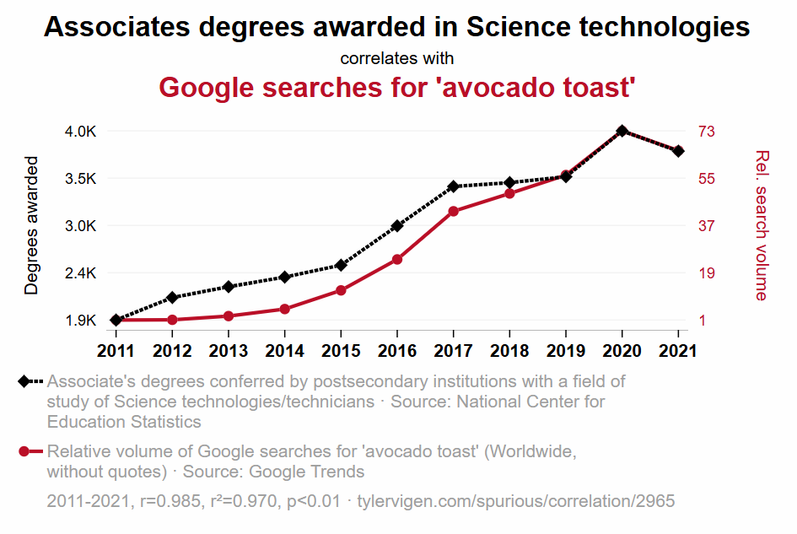
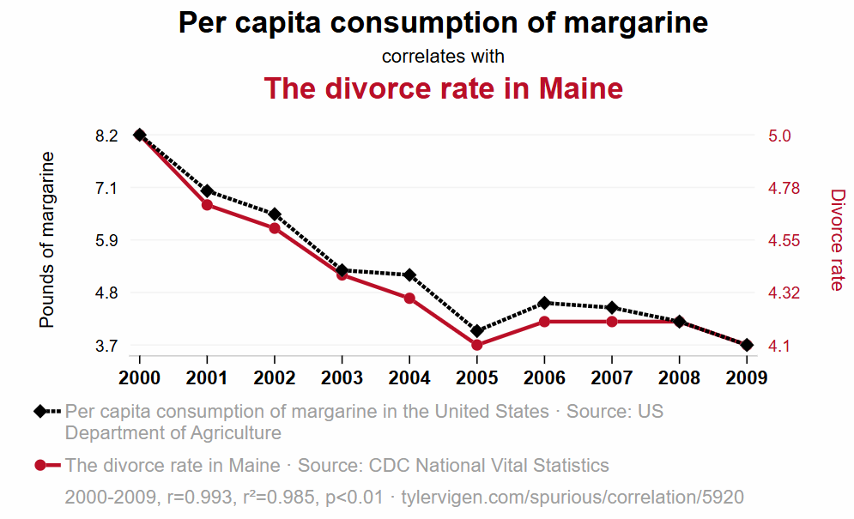
Module 2 · Video 3 · Demand Estimation
Spurious Correlations
tylervigen.com/spurious-correlations
Management 405 · Module 2 · Demand Analysis
44
Notes:
We call this omitted variable bias.
https://www.thegreatcoursesdaily.com/correlation-or-causality-wine-and-heart-health/
“But experts warn that the two studies, both published in the Annals of Internal Medicine, do not show that drinking coffee was behind the overall lower risk, pointing out that it could be that coffee drinkers are healthier in various ways or that those who are unwell drink less coffee. In addition, levels of coffee drinking were self-reported.”

Slide 45
Module 2 · Video 3 · Demand Estimation
Why Randomization Is Key
Randomizing prices ensures that “all else is equal” other than the price change
Allows us to estimate the causal effect of price on quantity demanded → the demand curve!
Management 405 · Module 2 · Demand Analysis
45

